Slide 1
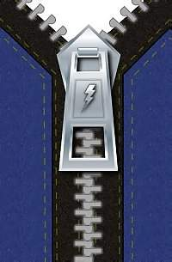
Business Alignment
Using Process Mining as a Tool for Delta Analysis
Prof.dr.ir. Wil van der Aalst
Eindhoven University of Technology
Department of Information and Technology
P.O. Box 513, 5600 MB Eindhoven
The Netherlands
w.m.p.v.d.aalst@tm.tue.nl

Slide 2
Outline
Motivation
Process mining: An overview
Measuring alignment
  Delta analysis
  Fitting cases into the process model
Conclusion

Slide 3
Motivation
New processes are emerging and existing processes are changing (“The only constant is change”).
The alignment of business processes and information systems requires continuous attention.
To “maintain the fit” it is important to detect deviations of the described or prescribed behavior.
Process Mining

Slide 4

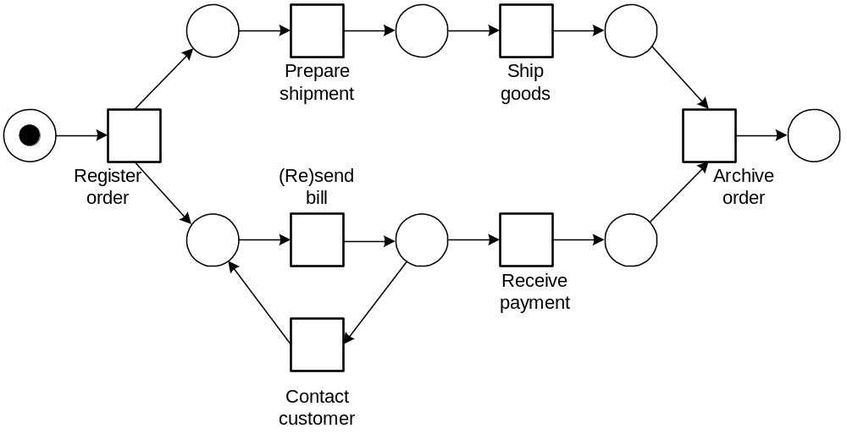
Process mining
process
mining
Process mining can be used for:
  Process discovery (What is the process?)
  Delta analysis (Are we doing what was specified?)
  Performance analysis (How can we improve?)
www.processmining.org

Slide 5
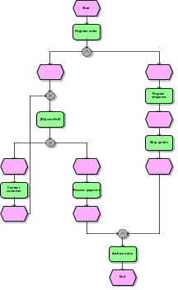
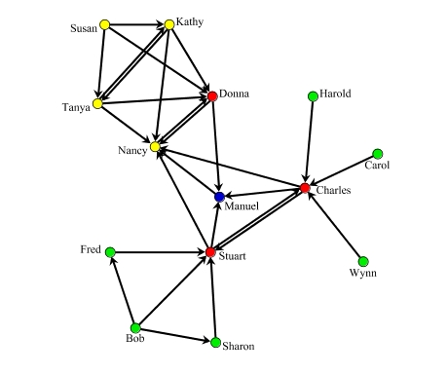
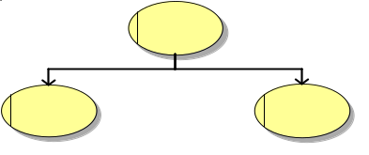



Process mining: Overview
2) process model
3) organizational model
4) social network
1) basic performance metrics
5) performance characteristics
6) auditing/security
If …then …

Slide 6
(1) Determine basic performance metrics
Process/control-flow perspective: flow time, waiting time, processing time and synchronization time.
Questions:
  What is the average flow time of orders?
  What is the maximum waiting time for activity approve?
  What percentage of requests is handled within 10 days?
  What is the minimum processing time of activity reject?
  What is the average time between scheduling an activity and actually starting it?
Resource perspective: frequencies, time, utilization, and variability.
Questions:
  How many times did Sue complete activity reject claim?
  How many times did John withdraw activity go shopping?
  How many times did Clare suspend some running activity?
  How much time did Peter work on instances of activity reject claim?
  How much time did people with role Manager work on this process?
  What is the utilization of John?
  What is the average utilization of people with role Manager?
  How many times did John work for more than 2 hours without interruption?

Slide 7
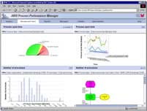
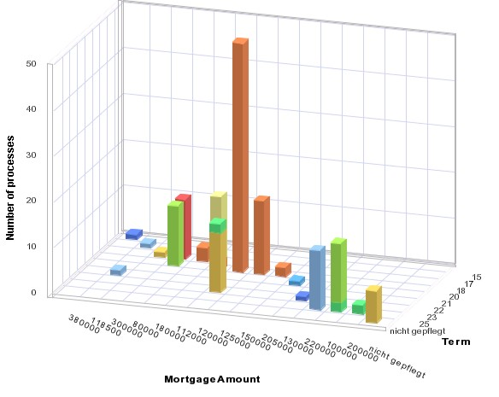
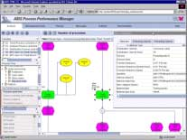
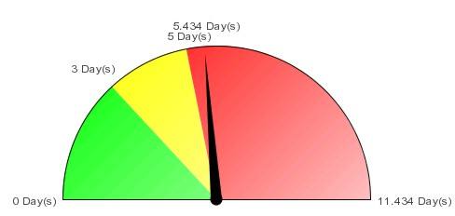
Example (ARIS PPM)
IDS Scheer's ARIS Process Performance Manager

Slide 8
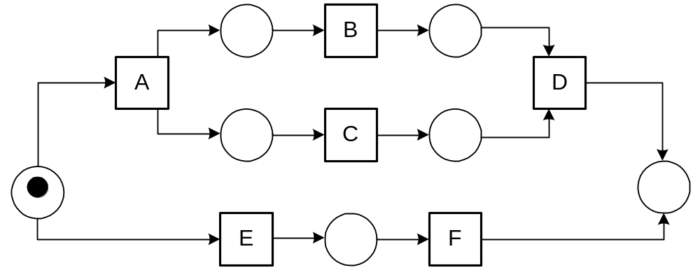
(2) Determine process model
Discover a process model (e.g., in terms of a PN or EPC) without prior knowledge about the structure of the process.
case 1 : task A
case 2 : task A
case 3 : task A
case 3 : task B
case 1 : task B
case 1 : task C
case 2 : task C
case 4 : task A
case 2 : task B
case 2 : task D
case 5 : task E
case 4 : task C
case 1 : task D
case 3 : task C
case 3 : task D
case 4 : task B
case 5 : task F
case 4 : task D
α(W)

Slide 9
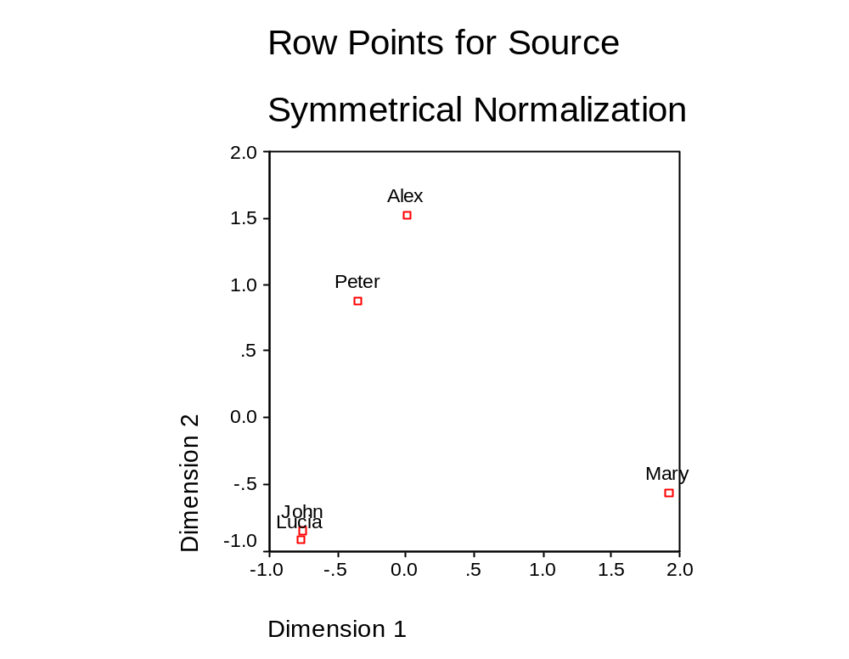
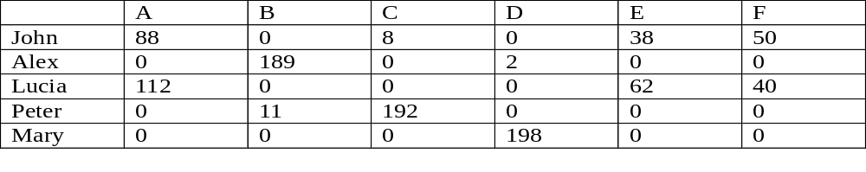
(3) Determine organizational model
Discover the organizational model (i.e., roles, departments,etc.) without prior knowledge about the structure of the organization.
e.g., correspondence analysis (typically applied in ecology)

Slide 10
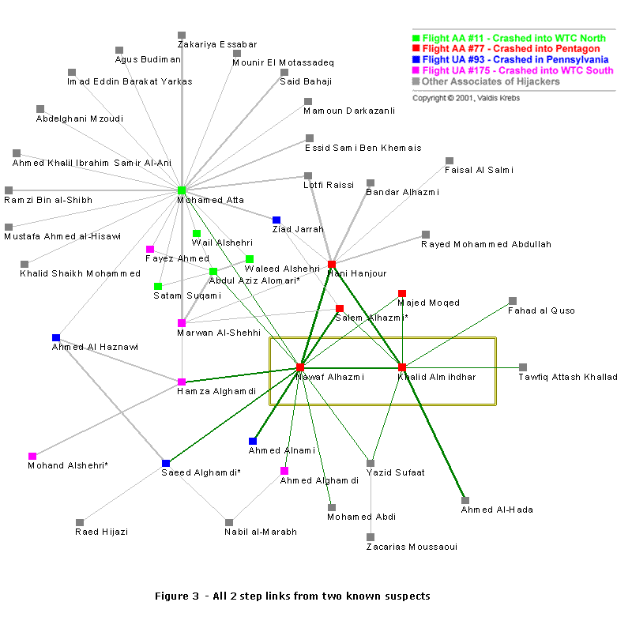
(4) Analyze social network
Social Network Analysis (SNA)
Based on:
  Handover of work
  Subcontracting
  Working together
  Reassignments
  Doing similar tasks

Slide 11
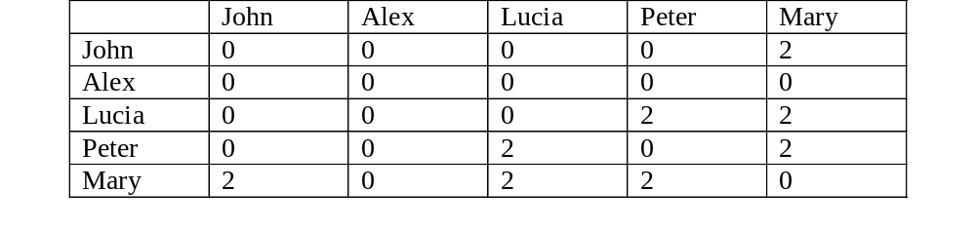
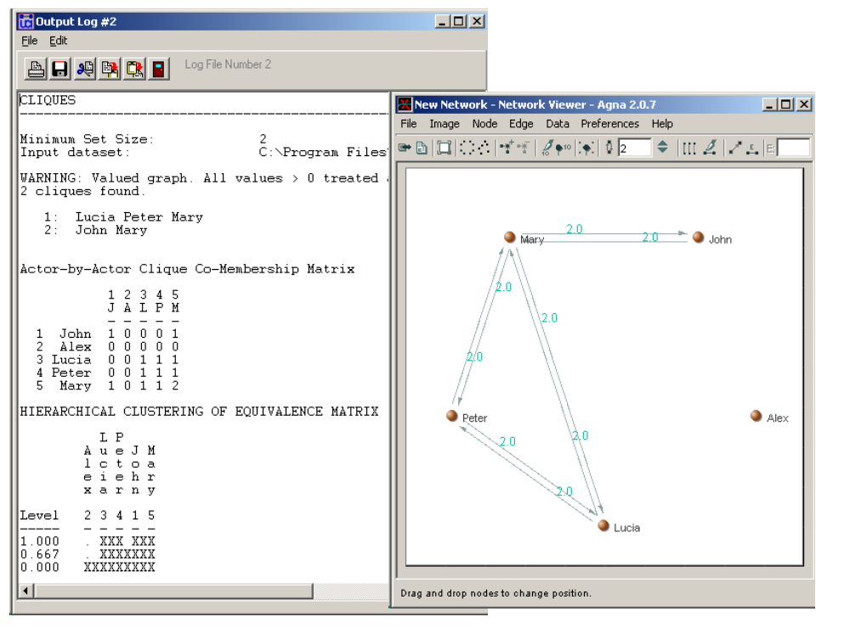
Example

Slide 12
(5) Analyze performance characteristics
Each case (process/workflow instance) has a number of properties:
  Resource that worked on a specific activity
  Value of a characteristic data element (e.g., size of order, age of customer, etc.)
  Performance metrics of case (e.g., flow time)
Using machine-learning techniques it is possible to find relevant relations between these properties.

Slide 13
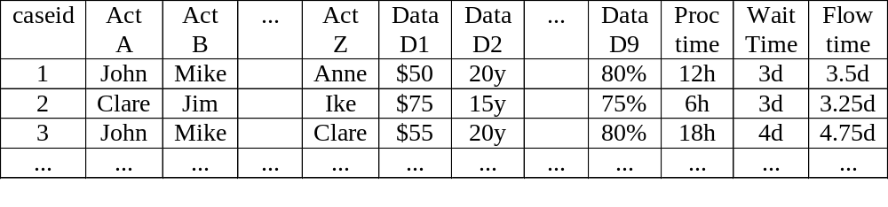
Example
If John and Mike work together, it takes longer.
Expensive cases require less processing.
Etc.

Slide 14


(6) Auditing/security
Ensuring that desirable patterns occur and that undesirable patterns do not occur.

Slide 15
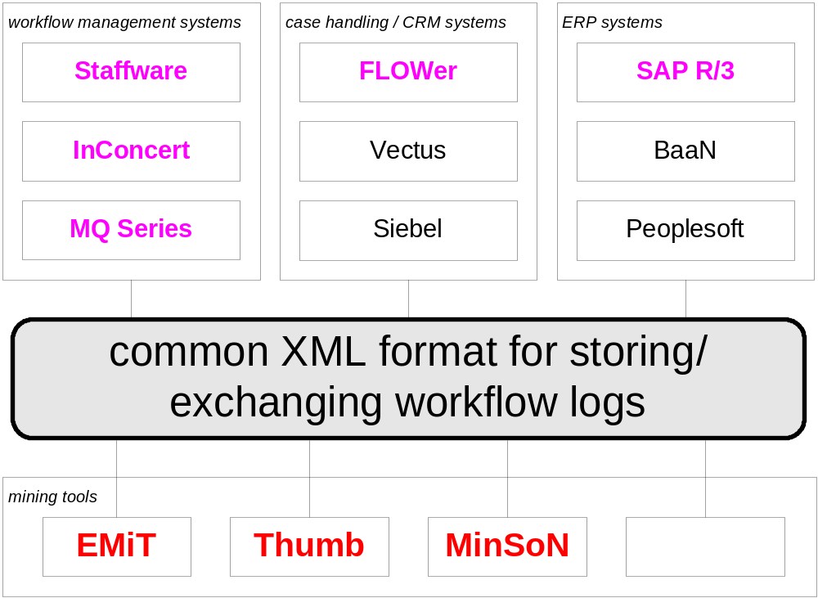
Process Mining: Tooling

Slide 16
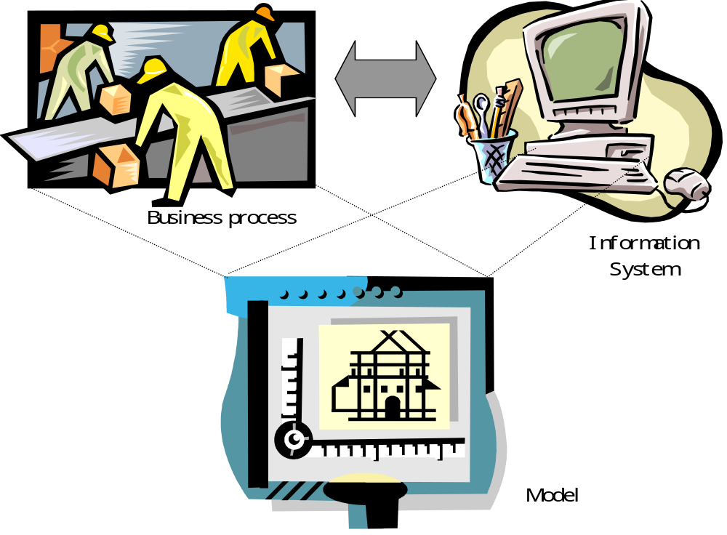
Measuring alignment
Models can be “prescriptive” or “descriptive”.

Slide 17
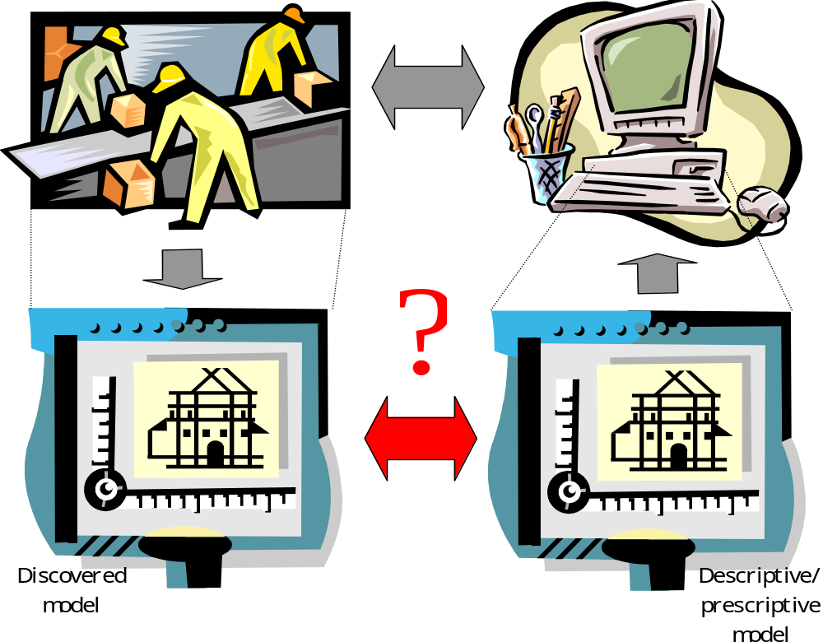
Approach 1: Delta analysis

Slide 18
Delta analysis
There are many ways to compare two process models, cf.:
  Equivalence notions (e.g., trace equivalence, b.bisim)
  Inheritance notions (e.g., life-cycle inheritance)
W.M.P. van der Aalst and T. Basten.
Identifying Commonalities and Differences in Object Life Cycles using Behavioral Inheritance.
In J.M. Colom and M. Koutny, editors, Application and Theory of Petri Nets 2001, volume 2075 of Lecture Notes in Computer Science, pages 32-52. Springer-Verlag, Berlin, 2001.

Slide 19
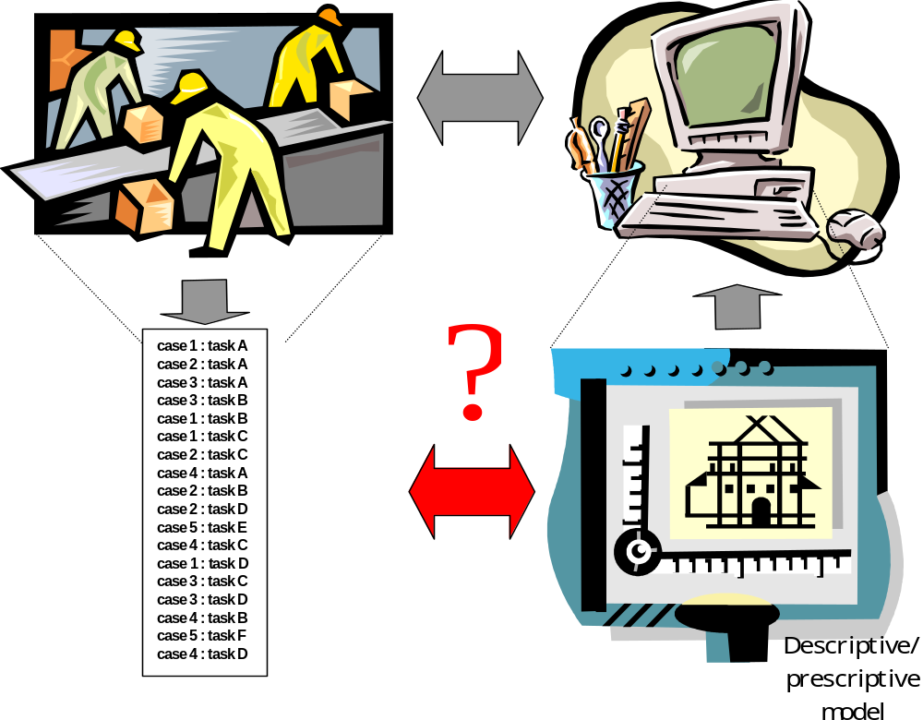
Approach 2: Fitting cases into the process model

Slide 20
Measuring the fit
Simply play the “token game” per case.
There are two types of errors:
  When playing the token game there are not enough tokens.
  When playing the token game tokens are left.
Both errors have a penalty and can be measured at the case (the percentage of cases not successfully parsed) or event/token level (the number of times a token needs to be borrowed/is left behind).

Slide 21
Example
Ten cases: ABCD, ACBD, ABD, EF, FE, EF, ABCD, ACD, AEFD, ACBD.
40% of the cases does not fit: ABCD, ACBD, ABD, EF, FE, EF, ABCD, ACD, AEFD, ACBD.
6 times a shortage and 6 times a surplus: ABCD, ACBD, AB-D+, EF, -FE+, EF, ABCD, AC-D+, A-EF--D+++, ACBD.

Slide 22
Conclusion
Process mining can be an interesting tool for actually measuring the alignment of business processes and information systems.
There are many challenges:
  Improving the algorithms (hidden/duplicate tasks, …)
  Gathering the data
  Visualizing the results
  Etc.
Join us at www.processmining.org

